Slide 1

Graphic Era(Deemed To Be University) Stock Visualization and Forecasting using python
Under the mentorship of
Ms. Meenakshi Maindola
Submitted by: Nikhil Singh
University Roll no.: 2016880
Section: CSE-I

Slide 2
Introduction
A stock, also known as equity, is a security that represents the ownership of a fraction of the issuing corporation.
Stock trading means buying and selling shares in companies to try to make money on price changes. Traders watch the short-term price changes of these stocks closely. They try to buy low and sell high.
The term stock market refers to several exchanges in which shares of publicly held companies are bought and sold. Such financial activities are conducted through formal exchanges and via over-the-counter (OTC) marketplaces that operate under a defined set of regulations.
Share prices generally go up and down because of supply and demand. However, they’re also influenced by these factors: information, economy, company’s financial health and external events.

Slide 3
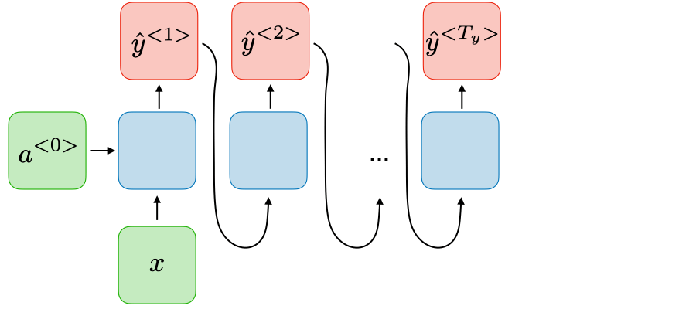
Methodology
Python Libraries: NumPy, Pandas, Scikit-Learn, Matplotlib, Keras, TensorFlow, Yfinance.
Long Short-Term Memory (LSTM) is one type of recurrent neural network which is used to learn order dependence in sequence prediction problems. Due to its capability of storing past information, LSTM is very useful in predicting stock prices. This is because the prediction of a future stock price is dependent on the previous prices.

Slide 4
Model
Firstly, we have imported all the library and download the Stock data using yfinance fetch method. We are forecasting the Close stock data of each day. The data needs to be scaled so for that we have used MinMaxScaler from sklearn preprocessing. The we used the sequential model for the time series data with the LSTM Layers forming the recurrent neural network.
The model is compiled with Adam optimizer and metric of mean squared error over the 70% of the scaled data. The remaining 30% of the scaled data is used for testing the model.
Front-end
We have streamilt for designing the UI of the application. Stream lit is an open-source app framework in Python language. It helps in creating web apps for data science and machine learning in a short time and is compatible with major Python libraries such as scikit-learn, Keras, PyTorch, SymPy(latex), NumPy, pandas, Matplotlib etc.

Slide 5
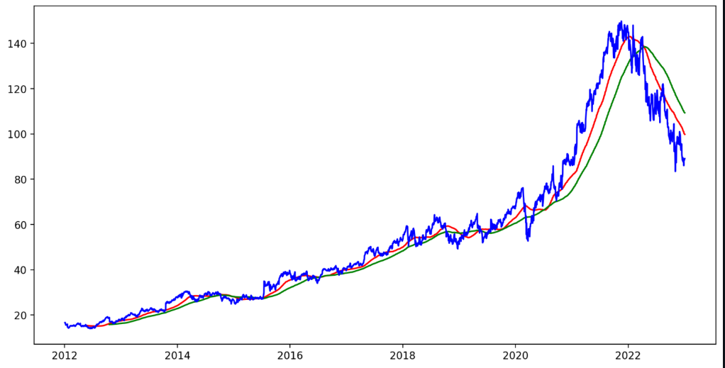
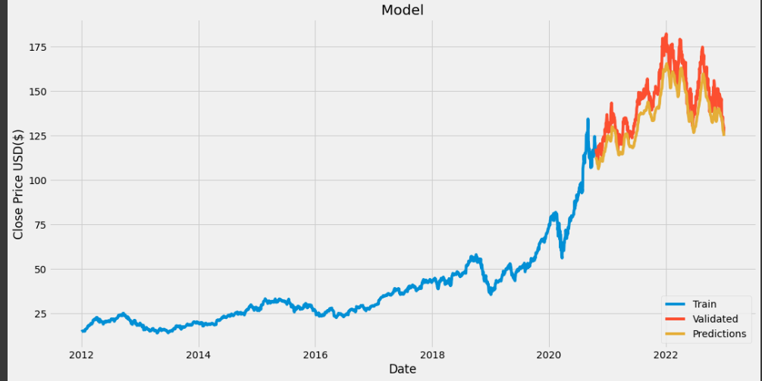
Result and Conclusion
We use the LSTM layers with the Sequential model which is forecasting the predictions with 60% of the accuracy.
We form this model by analysis the simple mean average of 100 and 200 days.
With the help of SMA we find the trend of the stock to go up or down.

Slide 6
Future Work
We can also make a model while considering multiple feature like open stock price, volume etc., to make multiple feature prediction model.
This will reduce the root mean squared error in the model and make the model more effective.
We also expands this model for fund, EFTS, NFTS and mutual funds.
We can also incorporate the trending tickers with the daily market news.

